Slide 1

SRI VENKATAESHWARA COLLEGE OF ENGINEERING AND TECHNOLOGY (AUTONOMOUS)
R.V.S Nagar, Chittoor – 517 127. (A.P)
Department of CSE(AI&ML)
Project Title:
ADVERSE DRUG EFFECT DETECTION
TEAM MEMBERS:
P. LAHARI (22781A33A2)
S. MOHAMMED KAIF BASHA (22781A33B0)
SHAIK SULEMAN (23785A3315)
M. NAGOOR BABU (22781A3390)
P. YUVARAJ (22781A33A4)
Mentor:
Dr, Kalpana
Guide:
Dr. K. Nandha Kumar
HOD :
Dr. M. Lavanya

Slide 2
AGENDA
INTRODUCTION
ABSTRACT
LITERATURE SURVEY
PROBLEM STATEMENT
OBJECTIVES OF THE PROPOSED SYSTEM
MODULE DESCRIPTION
METHODOLOGY & ALGORITHM
IMPLEMENTATION & EXECUTION
FUTURE SCOPE
CONCLUSION

Slide 3
INTRODUCTION
Background
Adverse Drug Effects (ADEs) are harmful reactions caused by medicines. Many side effects are identified only after drugs are widely used. Most ADE information is found in unstructured text such as clinical notes and medical reports, which is difficult to analyze manually.
Motivation
Manual drug safety monitoring is slow and inefficient. This project is motivated by the need to use Machine Learning and NLP to automatically detect adverse drug effects and reduce human effort.
Importance
Early detection of ADEs improves patient safety and supports better healthcare decisions. An automated system helps clinicians, pharmaceutical companies, and regulators monitor drug safety effectively.

Slide 4
Abstract
Adverse Drug Effects (ADEs) are harmful reactions caused by medicines and can affect patient health if not detected early. Many ADEs are reported late because the information is hidden in unstructured text such as clinical notes, medical reports, and patient feedback. Existing drug safety systems rely mostly on manual review, which is slow and inefficient.
This project develops a Machine Learning and Natural Language Processing (NLP) based system to automatically detect adverse drug effects from text data. The system identifies whether an adverse effect is present and extracts the related drug and symptom. An interactive dashboard is also created to visualize trends and high-risk drug–effect combinations.

Slide 5
Literature Survey
Existing Research
Previous studies have used manual methods and machine learning techniques to detect adverse drug effects from medical text. Recent work shows NLP-based models improve detection accuracy.
Methods Used
Statistical and rule-based approaches
Machine learning models (SVM, Random Forest)
NLP and Named Entity Recognition (NER) and Deep learning models like BERT
Identified Gaps
High manual effort
Poor handling of unstructured data
No real-time detection and Limited visualization and deployment

Slide 6
Problem Statement
Definition of the Problem
Adverse Drug Effects (ADEs) are often hidden within unstructured text such as clinical notes, medical reports, and patient feedback. Due to this, many adverse effects are not detected early, which can negatively impact patient safety and healthcare outcomes.
Limitations of Existing Systems
Depend mainly on manual review
Slow and time-consuming detection process
Poor handling of unstructured text data
No real-time monitoring or analysis
Limited visualization and explanation of results

Slide 7
Objectives of the Proposed System
Automatically detect adverse drug effects from text
Identify drug names and associated side effects
Analyze drug–effect relationships
Provide visual analytics for safety monitoring
Enable real-time detection through a web application or API

Slide 8
MODULE DESCRIPTION
• Data Collection Module
• Data Preprocessing Module
• Feature Extraction Module
• Model Training Module
• Prediction Module
• Visualization Module

Slide 9
METHODOLOGY & ALGORITHM
Methodology:
• Data collection and cleaning
• Feature extraction using TF-IDF
• Model training and evaluation
• Prediction using trained model
Algorithms Used:
• Random Forest Classifier
• Logistic Regression

Slide 10
IMPLEMENTATION & EXECUTION
• Implemented using Python and Streamlit
• Machine learning model trained offline
• Model and vectorizer saved using Pickle
• Web app predicts adverse drug effects in real-time

Slide 11
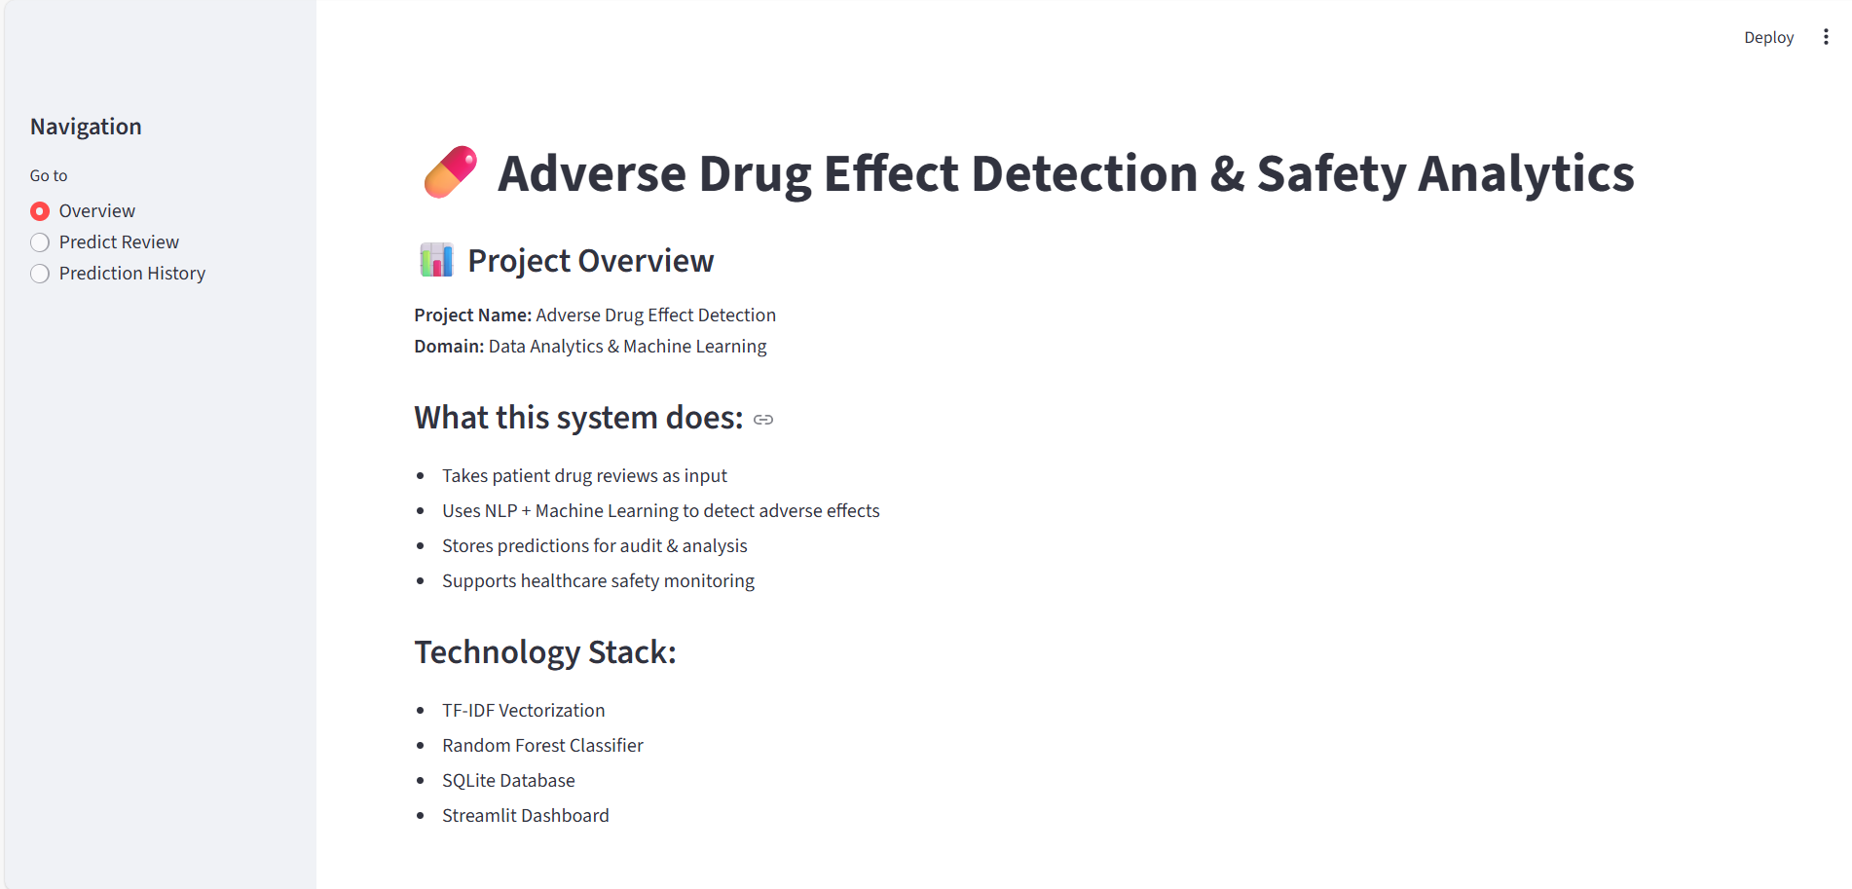
OUTPUT SCREENSHOTS
OVERVIEW :

Slide 12
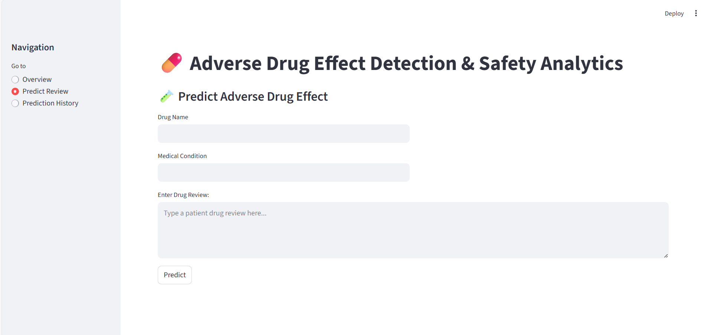
PREDICT REVIEW :

Slide 13
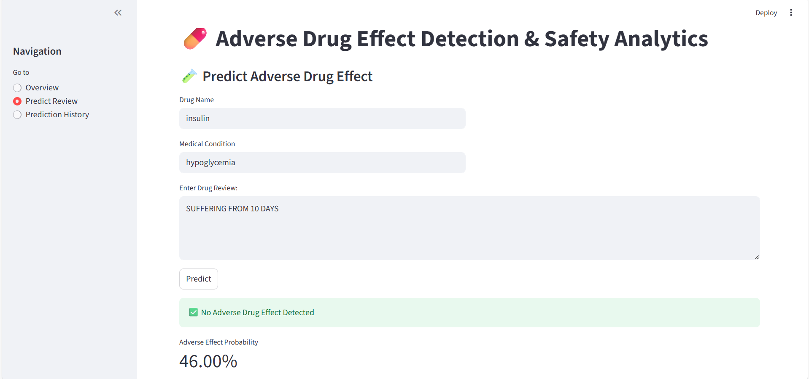
SAFETY DRUG DETECTION :

Slide 14
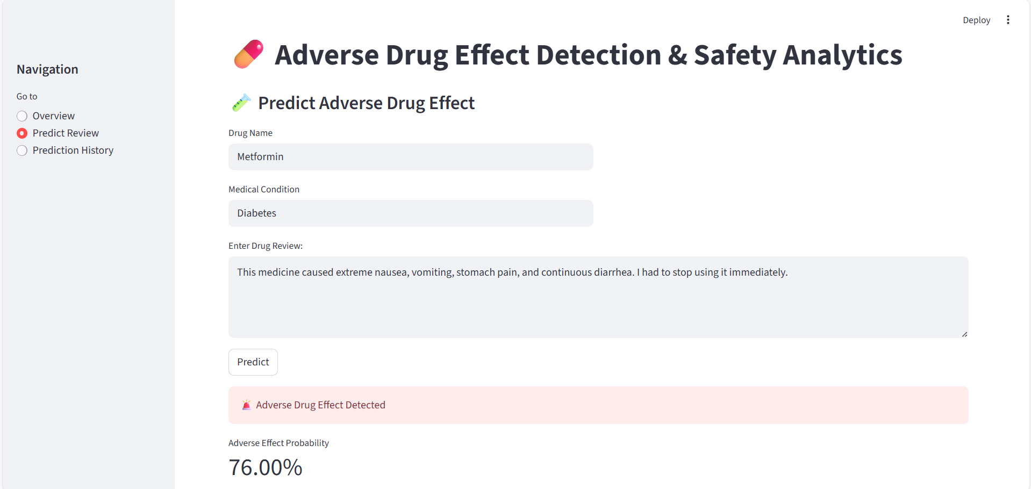
ADVERSE DRUG DETECTION :

Slide 15
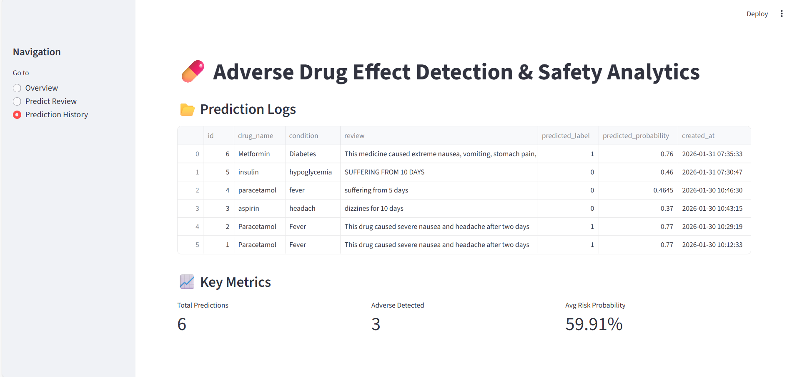
PREDICTION HISTORY :

Slide 16
FUTURE SCOPE
Integration with hospital databases
Use of deep learning models
Multilingual review analysis
Cloud deployment
Real-time pharmacovigilance systems

Slide 17
CONCLUSION
This project demonstrates the effective use of machine learning and NLP in detecting adverse drug effects from patient reviews. The system improves drug safety monitoring and supports data-driven healthcare decisions.

Slide 18
Thank You
GitHub Link : https://github.com/Kaif0333/Adverse-Drug-Effect-Detection.git

